Slide 1

Smart Streetlight
Proof of Concept
Thor Cutler
Tucker Russ
Anthony Giordano
Brandon Berry
Group 9
10/22/15

Slide 2
Overview
Group 9
Tucker
Introduction
Current/Future System
Raspberry Pi SSLS User Interface
XBee Communication
LED Lighting Specifications
DC Power Supply Specifications
Smart Meter Incorporation

Slide 3
Entrepreneurial Project
Group 9
Tucker
Project is fully funded by the Entrepreneurial Senior Design Department under Dr. Devine
Funding for the project is covered up to $1,500
Designed with special entrepreneurial characteristics
  Show the cost/benefits of implementation on FSU’s campus
  Create a real-time SSLS demo model proving this concept
  Have the potential to bring the demo to other campuses demonstrated

Slide 4
Introduction
Group 9
Tucker
Fully working Smart Streetlight System Demo Model
Give exposure to new Smart Grid Technology
Build design using our design and programs
Minimum of two Streetlights, a Smart Meter, and a User Interface Device
Show advantages of implementing Street Lights on our Campus

Slide 5





Todays Scenario
Group 9
Tucker
When a Streetlight, House, or Campus Building looses power
The only way the utility company knows of the outage is if a customer calls in to report the outage and the its location

Slide 6
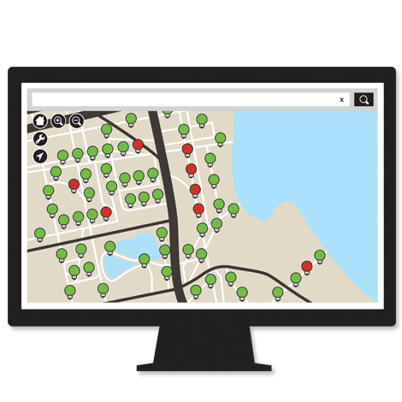
Smart Streetlight System Scenario
Group 9
Tucker
When a Streetlight, House, or Campus Building looses power
The utility company is immediately notified of the outage and the location
Notes:
This allows them to not only know the exact time of the outage but also if other devices are effected (Ill talk more about that) and the exact location so they can pinpoint the problem which leads to less troubleshooting

Slide 7


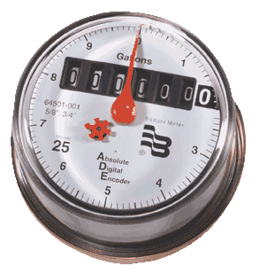

Mesh Network on Campus
Group 9
Tucker
Notes:
Each Streetlight now becomes a Node to the entire mesh network. The more streetlights the stronger the mesh network becomes. Now any Buildings can now be connected to these nodes by the Smart Meters on the building. This strengthens the mesh network and now brings the same functionality to buildings. With the number of streetlights on our campus this picture would be a good representation of Smart Streetlights being implemented on campus.

Slide 8
Benefits
Group 9
Tucker
Time since outage
Location of outage
More information leads to less troubleshooting to find where fault is located
Potential to do research, estimate costs of power saving ideas, etc.
Change existing streetlight bulbs to LEDs

Slide 9
System Requirements
Group 9
Thor
Requirement Code | Requirement Statement | Need Mapping | Explanation
R_S1 | The SSLS shall alert a user within 10 seconds of a monitored device losing power. | N_S1 N_S2 | The purpose of this requirement is to document one of the basic functions of our project. When a street light or smart meter loses power, the system user, by looking at the system’s monitor, will be alerted of the power loss.
R_S2 | The SSLS shall constantly show the status of all monitored devices, updating every 10 seconds. Status consists of: -Powered on or off -last updated -voltage -current -power | N_S3 N_S4 N_S8 N_Want1 N_Want3 N_want4 | The purpose of this requirement is to ensure that the system will constantly be updating data on a set time interval and not just when a monitored device loses power.
R_S3 | The SSLS shall receive status signals from monitored devices wirelessly. | N_S5 N_S6 N_S7 | The purpose of this requirement is to simulate that street lights are far enough apart that a wired connection isn’t practical
R_S4 | The SSLS shall be able to differentiate between different monitored devices by the signal that they send. | N_S7 | The purpose of this requirement is to ensure that each light sends a slightly different signal as to allow the user to know which light has lost power.

Slide 10
System Requirements Example Test
Group 9
Thor
Test R_S1:
A monitored device on the SSLS Demo Model will be turned off and a timer will be started.
  _____ In 10 Seconds or less the SSLS Demo Model monitor needs to have updated information.
  _____ The updated information must accurately show which monitored device has lost power.
  _____ The updated information must show how long ago the monitored device lost power accurate to +- 10 seconds.

Slide 11
Components
Group 9
Thor
Streetlight
Transmit Data
Receive Data
Smart Meter
Raspberry Pi
Receive
Data
Transmit Data
Receive Data

Slide 12
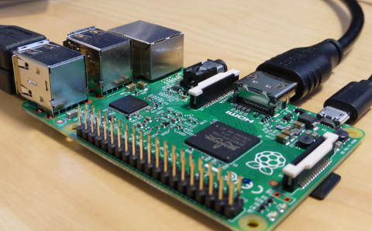
Raspberry Pi 2
Group 9
Thor
900MHz quad-core Cortex-A7 CPU
1GB RAM
4 USB ports
Full HDMI port
40 GPIO pins
Micro SD card slot
Linux Raspbian loaded
XBee functionality using GPIO pins

Slide 13
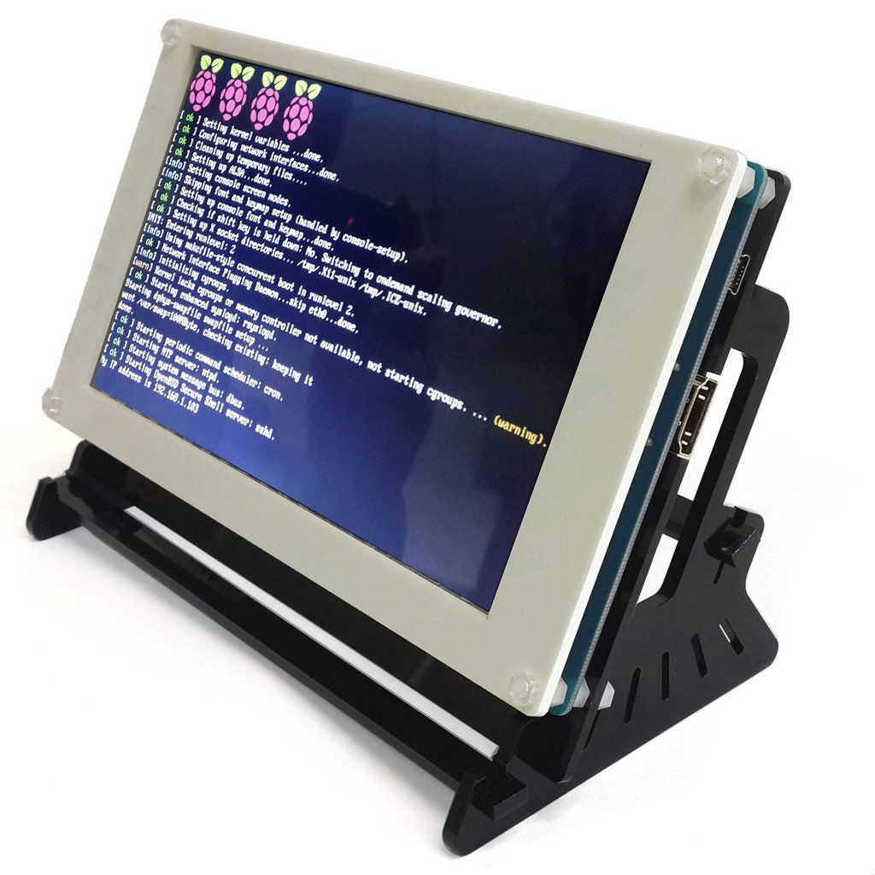
SSLS User Interface
Group 9
Thor
Real-time status notifications every 10 seconds or less
Touchscreen UI for simplicity
  Configurable using EVTest to find screen bounds
  Input these bounds in Rasbian root file:
    Sudo/nano/FILE/ ->
    Usr/share/X11/xorg.config.d/10-evdev.conf
UI will most likely be written in Python
  Chosen to easily interact with the Rapberry Pi’s GPIO pins

Slide 14
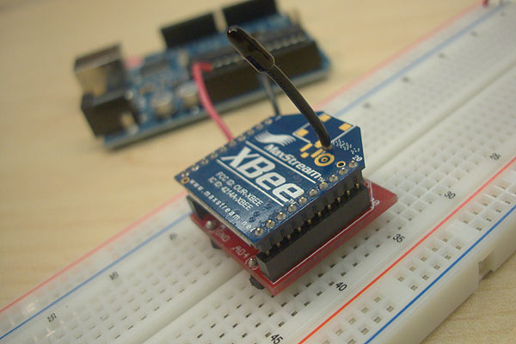
XBee Series 1
Group 9
Thor
2.4GHZ using IEEE 802.15.4
P2P and multi-point Mesh Network
3.3V, 50mA Input
300ft max outdoor range
1mW Output
6 10-bit ADC input pins
65536 Channels
Local or over-air configuration

Slide 15
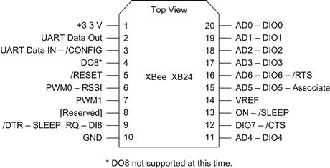
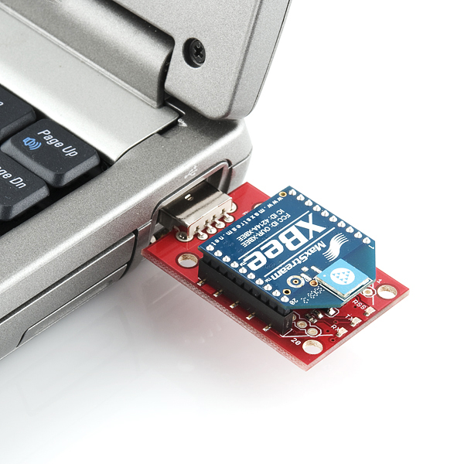
Configuration
Group 9
Thor
XBee devices will be configured using X-CTU, a free multi-platform application by Digi
It is generally used for simple designs and test conditions
In the future we will need to develop code to receive signals from the monitored devices

Slide 16
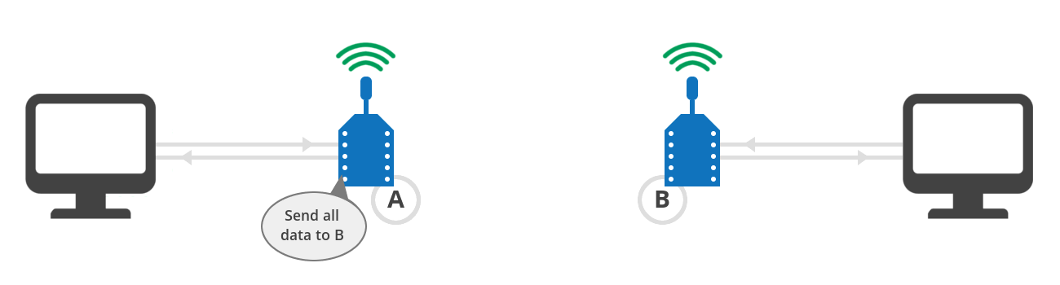
Demonstration
Group 9
Thor
We are currently able to send signals using two XBee devices, allowing communication between two computers

Slide 17
Model Requirements
Group 9
Brandon
Requirement Code | Requirement Statement | Need Mapping | Explanation
R_M1 | The SSLS Demo Model shall be built on a cart making it mobile. | N_M3 | Our whole demo will be built on a cart allowing presentations to be held in multiple locations and making working on the Demo easier.
R_M2 | The SSLS Demo Model shall have a monitor to display the status of all monitored devices. | N_M2 N_Want6 | The Demo will have the screen that displays the SSLS information for each light covered in R1 and R2.
R_M3 | The SSLS Demo Model shall have at least 1 street light and 1 smart meter that can be shut off to represent power loss. | N_M1 | This part of the model will be used to represent power loss in a light allowing us to display how the system reacts to power loss in a monitored device.

Slide 18

Model Design
Group 9
Brandon
Model will be on a mobile cart
Plexiglass will display electric components
Model buildings will represent buildings of a city or campus

Slide 19
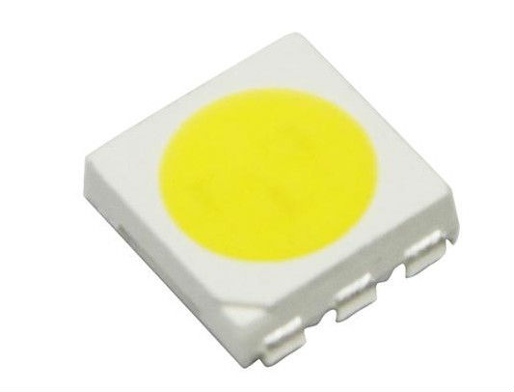
LEDs for Model
Group 9
Brandon
5050 SMD (Surface Mount Diode)
Dimensions: 5.0mm X 5.0mm
Power Draw: 60mA @ 2.8 - 3.4 Volts
Lumen Flux: 16-22 lumens

Slide 20
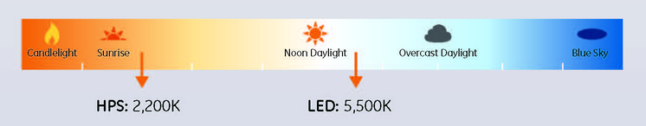
Benefits of LED’s
Group 9
Brandon
LEDs provide whiter light
LEDs – 5500K vs. HPS(High Pressure Sodium) – 2200K

Slide 21

Angle of the lighting
Group 9
Brandon
Light from LEDs can be directed
Better light distribution, eliminating dark spots
Less street lights are needed
Improved vertical lighting, better visibility for drivers

Slide 22

Lower Cost & Environmentally Friendly
Group 9
Brandon
At 10 hours per night:
HPS - 290 watts | 1058 kwh per year
LED - 125 watts | 456 kwh per year
Less power means less CO2 emissions
Less maintenance mean less overall operation cost

Slide 23
Street Light
Group 9
Brandon
3D Printed model street lights
XBee and LEDs will be built into the street light
They will be connected in parallel with the XBee connected to a backup battery

Slide 24
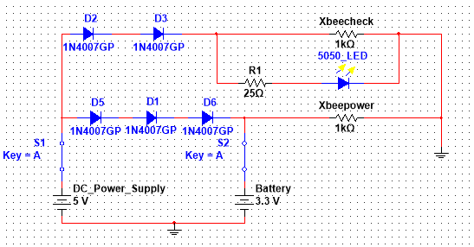
Power Schematic for XBee & LEDs
Group 9
Brandon

Slide 25
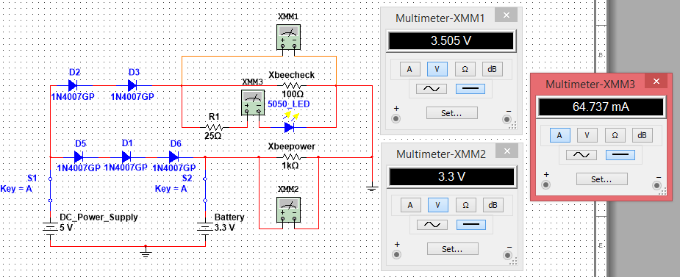
While DC Power is Connected
Group 9
Brandon

Slide 26
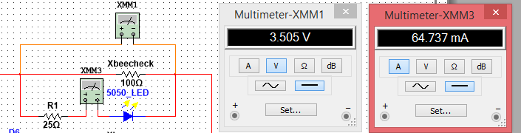
LED Input Current and Voltage
Group 9
Brandon

Slide 27
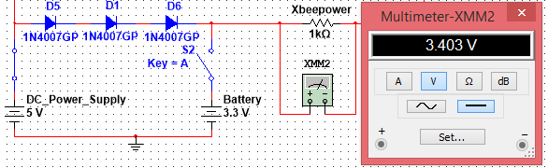
Battery and XBee Input Voltage
Group 9
Brandon
Three Diodes are used to reduce the voltage from 5 to 3.4 volts

Slide 28
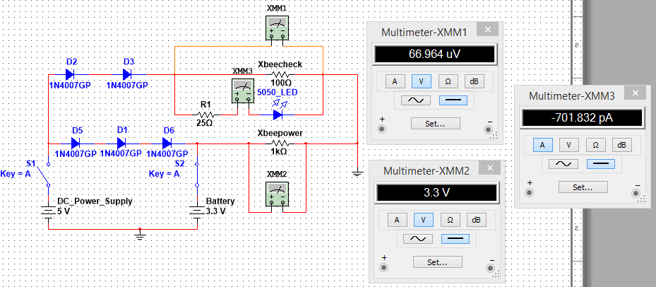
While DC Power is Disconnected
Group 9
Brandon
Diodes are used to prevent the backflow of current when the DC power supply goes down
This allows the XBeeCheck to see that the DC power supply has stopped working while the XBee itself still receives power

Slide 29
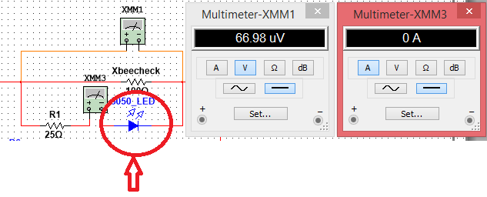
LED is off when the DC Power goes down
Group 9
Brandon

Slide 30
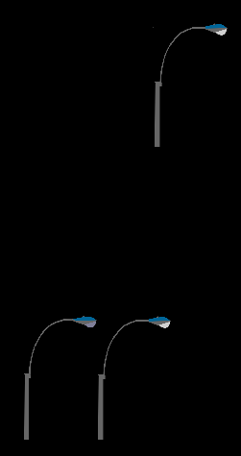
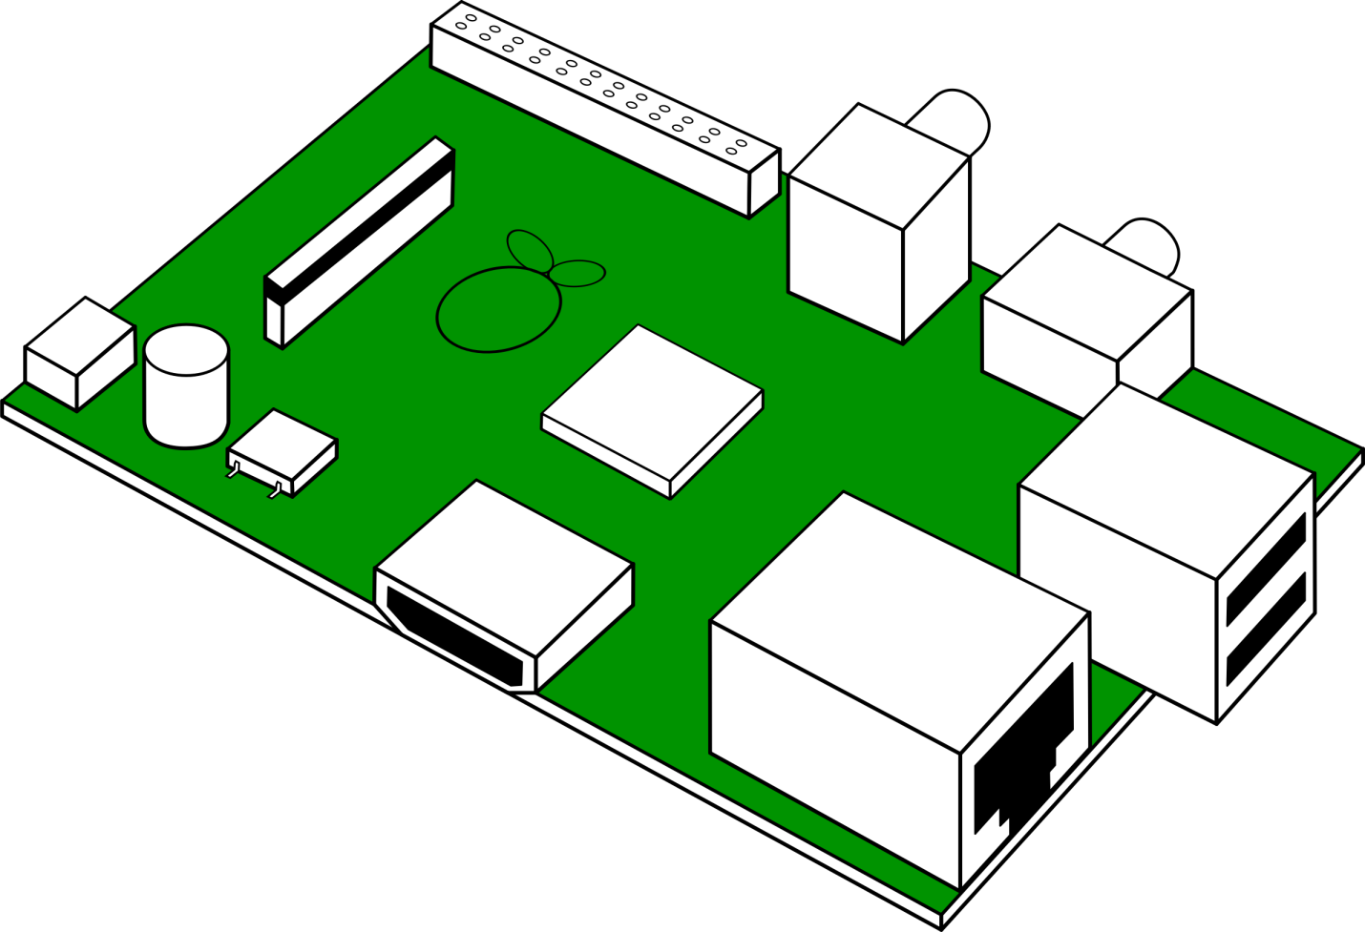

What Will Be Powered?
Group 9
Anthony
3 XBee: 3.3V each 50mA
3 LEDs: 2.8-3.4V, 60mA-80mA
                -Two on cart
            -One far away
Raspberry Pi 2: Running at 5V
Digi XBee Smart Plug running at 120V

Slide 31
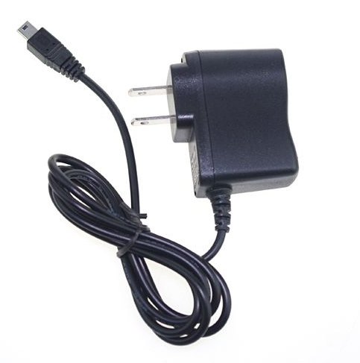

Power Supply
Group 9
Anthony
Three 5 Volt 1 Amp DC power supplies
Individual power source per streetlight in order to recognize which power source is out

Slide 32
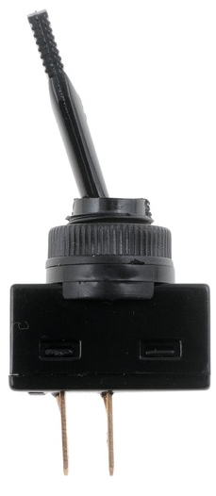

Toggle Switches
Group 9
Anthony
1 switch per Streetlight (3 total)
1 switch for Smart Meter
1 Main Turn Off switch

Slide 33
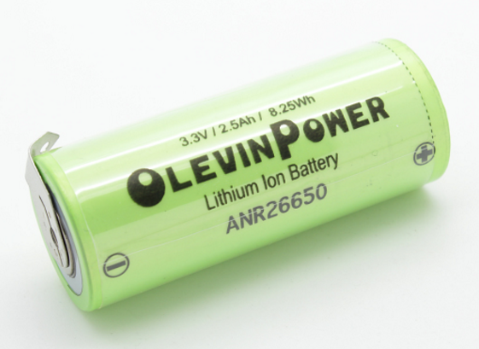

Lithium Ion Battery
Group 9
Anthony
3.3V Supply
Will supply power to XBee in the case of a power loss
Not using a capacitor due to the required time the XBee needs to stay on

Slide 34
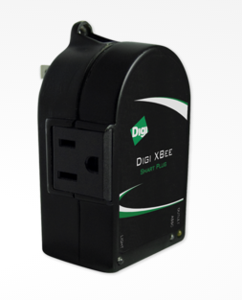
Digi XBee Smart Plug
Group 9
Anthony
Functions as a household Smart Meter
Ability to communicate with all XBees in the network
Enables users to measure and control connected electrical devices, maximizing energy efficiency and reducing cost
Runs off of 120V, 8A rated socket

Slide 35
Power Layout
Group 9
Anthony
Smart Meter
w/XBee
LED
120V
5V DC
5V
Streetlight 1
5V DC
5V
Streetlight 2
120 V
5V DC
5V
Raspberry Pi
5V DC
5V
Streetlight 3
120 V

Slide 36
Questions?
Group 9

Slide 37
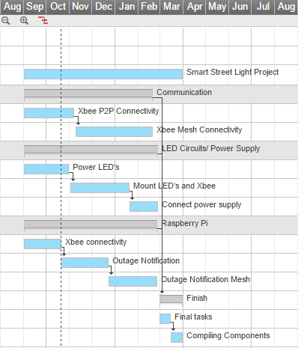
Group 9

